Slide 1
Relational Database Design & Implementation for an Online Retail Store
Creating a Clean, Reliable Online Store Backend Using PostgreSQL
Core Deliverables: 7-Table Clean Structure, Automated Safety Rules, and Faster Queries.
Presented by : Arun Raju

Slide 2
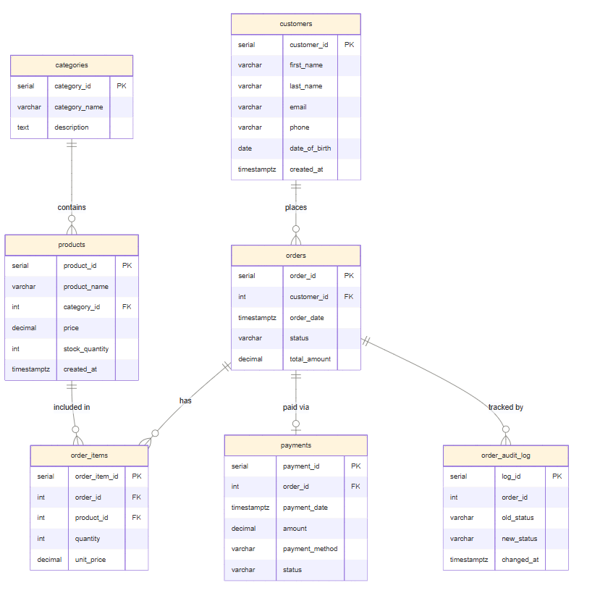
How the Tables ConnecT

Slide 3
Normalization (Fixing Messy Data)
* 1 NF Step 1: One Value Per Cell
Rule: No lists or groups inside a single cell.
Example: A customer's phone number or an order's items get their own separate rows, not stuffed together
* 2 NF Step 2: Isolate Item Details
Rule: Everything in a link table must belong to that specific link.
Example: order_items only tracks things like quantity and item price. Customer details stay in the customer table
* 3 NF
Step 3: No Chain Dependencies
Rule: Tables must only store data about their actual topic.
Example: Category names live only in the categories table. They are never copied inside individual product rows.

Slide 4
Choosing Data Types & Setting Safety Guardrails
SMART STORAGE - DECIMAL(10,2): Used for prices and totals. This prevents weird rounding bugs that happen with standard number formats.
- TIMESTAMPTZ: Automatically captures the exact time and timezone for every order.
- VARCHAR: Keeps text data neat and bounded for names and emails.
Automatic Safety Rules - CHECK (price > 0): The database automatically rejects any product with a 0 or negative price.
- CHECK (stock_quantity >= 0): Prevents inventory counts from ever dropping below zero.
- UNIQUE (email): Blocks two different customers from signing up with the exact same email address.

Slide 5
Connecting Our Tables Together (Joins)
INNER JOIN (Perfect Matches): Only pulls rows where data matches on both sides. Example: Linking active orders directly to the specific customer who placed them.
LEFT JOIN (All Left Side Data): Pulls every single customer, even if they have never placed an order. Use Case: Perfect for identifying inactive accounts for marketing.
RIGHT JOIN (All Right Side Data): Pulls all orders from the right side, ensuring no order record is left behind while matching whatever customer data exists.

Slide 6
Connecting Our Tables Together (Joins)
FULL OUTER JOIN (The Complete Map): Combines everything. Pulls all customers and all orders, matching them where possible and leaving blank spaces where they don’t.
CROSS JOIN (All Possible Combinations): Multiplies every row of the first table by every row of the second table. Example: Pairing every single product category with every single payment method to see all possible combinations.
SELF JOIN (Table Matching Itself): Compares a table against itself. Example: Looking at the customers table to find distinct pairs of users who live in the exact same city.

Slide 7
Calculating Business Metrics & Summaries
The Math Behind the Store
SUM & AVG: Used to calculate total store revenue and the average price of products in our catalog.
GROUP BY: Bundles rows together to calculate totals per category or per customer.
HAVING Rule: Filters our grouped data. For example, ignoring small orders and only looking at big spenders.

Slide 8
Subqueries (Queries Inside Queries)
Smart Filtering with Subqueries
Queries Inside Queries
What it is: Placing a temporary query inside your main query to handle dynamic data.
The Problem: We want to find products that cost more than our average price. But our average price changes every time we add a new item!
The Solution: Use a subquery to calculate the average price first, then hand that number to the outer query.

Slide 9
Database Speed & Performance Tuning
Making Queries Faster (Indexing) The Problem: Without indexes, PostgreSQL has to do a "Sequential Scan” meaning it reads every single row in a table from top to bottom just to find one thing. This slows down drastically as the store grows
The Solution: We built B-Tree Indexes. Think of this like the index at the back of a textbook; the database jumps straight to the correct page.
What We Checked: We ran EXPLAIN ANALYZE before and after to physically read the speed improvements.

Slide 10
Creating Shortcuts with Database Views
What are Views? Virtual Tables: A view saves a massive, complex query inside the database so you can call it with a simple SELECT * FROM view_name;.
Why Use Them: * Cleans up code for frontend apps or Power BI dashboards. Hides background table complexity from unauthorized users.
Our 3 Custom Views: Complete Order Summaries, Customer Purchase Profiles, and Live Inventory Trackers.

Slide 11
Safe Checkouts Using Transactions
The Risk: What happens if a customer places an order, the system subtracts the inventory stock, but the payment gateway crashes? Your database gets corrupted.
The Safe Way (ACID): Transactions ensure that a bundle of SQL commands must all succeed together, or the whole thing fails completely.
BEGIN & COMMIT: Opens the safety window and saves changes only if everything works perfectly.
ROLLBACK: Instantly undoes everything if an unexpected error occurs mid-way.

Slide 12
Smart Automation with Stored Procedures
Why Use Procedures? What it is: A stored procedure is a custom script saved inside the database that runs multiple steps in a specific order with a single call.
The place_order Workflow: 1. Checks if we have enough stock. 2. Creates the order and calculates the math. 3. Subtracts items from inventory and logs the payment.
The Benefit: Instead of writing four separate commands in an app, you just run CALL place_order(...) and the database handles the rest instantly.

Slide 13
Custom Math & Calculations (Functions)
Procedures vs. Functions :
The Difference: While procedures do tasks, functions calculate data and return an exact answer on the spot.
Our 2 Custom Functions:
get_customer_age: Automatically calculates a user's current age based on their date of birth.
get_category_revenue: Instantly calculates total sales for an entire department while ignoring cancelled orders.

Slide 14
Event-Driven Automation (Triggers)
The Invisible Security Guard
What it is: A trigger listens for actions like updates or deletions and automatically fires a security script in response.
Trigger 1: Automatic Audit Log (trg_order_status_change) Anytime an order status changes (e.g., from 'pending' to 'shipped'), it instantly logs the old status, new status, and timestamp to a separate audit table.
Trigger 2: Fraud & Deletion Protection (trg_prevent_delete_delivered) Intercepts and physically blocks anyone from deleting an order that has already been delivered.

Slide 15
Project Summary & Key Takeaways
Built a fully normalized, secure, and production-ready e-commerce database from scratch.
Shielded data integrity directly at the storage layer using constraints, transactions, and triggers
Optimized query speeds via strategic B-Tree indexing for a seamless consumer experience.

